Slide 1

Business, Bytes, & Brews
June 24, 2026
How to Get Your Message Out Through the News Media
Mike Ferlazzo, Director of Media Relations

Slide 2
Of press releases, reporting impact and elevator pitches

Slide 3
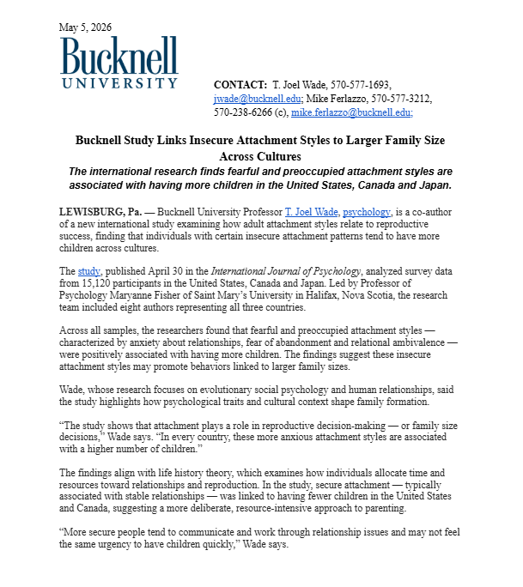
Press release 101

Slide 4
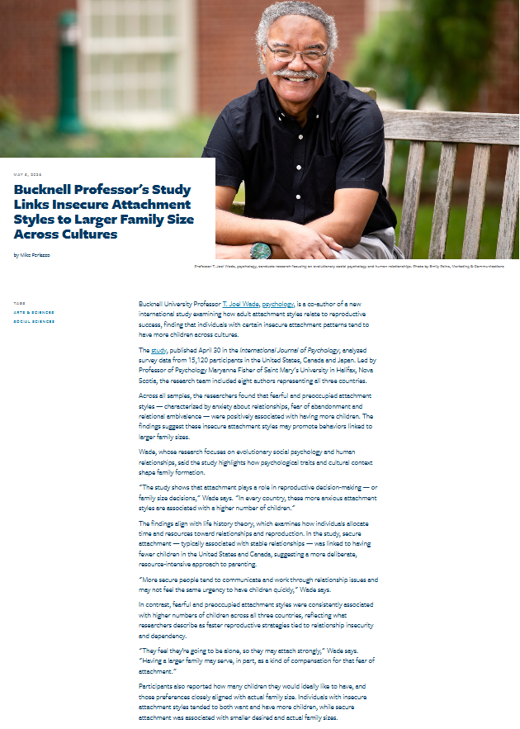
Press release 101

Slide 5
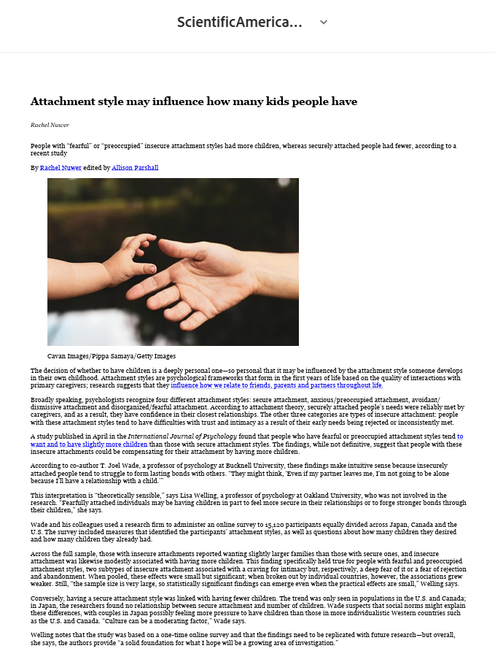
Press release 101

Slide 6
Press release 101
The death of the press release has been greatly exaggerated!
  Press releases have historically been a key tool for attracting favorable media attention, shaping public perception, highlighting events or professional achievements and increasing brand awareness via media.
  And yet amid persistent reports of falling newspaper circulation and newspapers, declining TV news viewership, diminished radio reach, consolidation in the broadcast communications industry, pundits wondered aloud whether press releases were dead.
  Even the Public Relations Society of America published an article bemoaning the end of the press release.

Slide 7
Press release 101
With alternate channels for distribution of real-time news and announcements, declining visibility and widespread reports of the press release’s imminent demise, the question remains: Are press releases dead?
  The answer is a resounding NO!!
  For small and midsize businesses, the press release is still the preferred and usually the only channel for garnering widespread coverage across a wide range of news sources, from print and broadcast media, trade journals, websites and social media.
  The modern press release may serve a somewhat different role in today’s communications playbook, but it’s still very much alive and kicking!

Slide 8
Press release 101
How to write a press release
The art of writing the press release is about balancing the story your company is trying to tell while making it digestible for your desired audience.

Slide 9
Press release 101
Make sure it’s newsworthy
When deciding whether to write a press release, determine whether journalists are going to find your news interesting enough to share with their readers, or is it only interesting to you and your company?
To avoid ending up in a reporter’s email trash folder, most PR professionals recommend saving press releases for major announcements, like new products or services, industry recognition, or special events.

Slide 10
Press release 101
2. Craft a short, interesting headline.
As a rule of thumb, your press release headline should be able to fit into Twitter’s old 280-character limit. Reporters are bombarded by emails, but sending a link to your press release through Twitter/X and email increases the likelihood of having it read. Having it be short enough to be read on.
The email subject line is very important. If you want your press release to be read, your subject line should answer the question ‘why should I care?’ If you cannot convince a reader why they should care with your subject line, your press release will never be read.”

Slide 11
Press release 101
3. Cover the basics.
The first lesson most journalists learn about news reporting is to cover the five W’s and one H:”
    Who?
    What?
    When?
    Where?
    Why?
    How?
These basic pieces of information make up the core of a news story and get the facts across in a clear, concise way. Your release should include them all upfront.

Slide 12
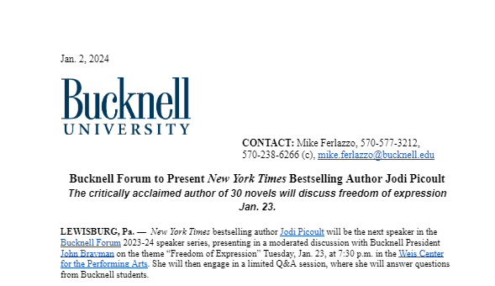
Press release 101

Slide 13
Press release 101
4. Clean it up.
The fastest way to turn off a journalist is to include mistakes and inaccuracies. Make sure your press release is free from errors. When drafting a press release, writing copy that is grammatically correct is critical.
Also be concise and include real facts, a quote from an expert source, and a link to the brand’s website and social media channels. This will ensure that the message is relayed clearly, as the press release can potentially be passed through to multiple editors and journalists.
A great resource to aid you in writing and improving a press release is the Associated Press Stylebook, which gives you an up-to-date guide on word usage and styling for public-facing content.

Slide 14
Press release 101
When to issue a press release.
Finding the right time to send a press release can be challenging. It used to be 10 a.m., or once the journalist was settled at their desk. The general consensus now is that the peak times for sending a press release are between the hours of 10 a.m. and 2 p.m. on Tuesday, Wednesday, and Thursday.
Avoid sending your press releases early in the morning or toward the end of the work day. You’re not going to get the most out of your releases at these times. Friday is also a no-go for press releases. Though you may catch some people, the open rate tends to be low, similar to the rate on weekends.

Slide 15
Reporting impact

Slide 16
Reporting Impact
How Do I Measure the Success of My Press Release?
Measuring the performance of a press release depends on your particular goals. Of course, pickup by the media is the ultimate goal but you’ll likely have other metrics as well to support your effort. Your goals will determine the specific metrics to use in your press release evaluation.
A pickup occurs when a journalist sees your press release and creates a separate piece of content, such as an article or post. This is an example of earned media and translates into free press coverage一perhaps the most valuable metric related to press release distribution. Earned media can lead to increased brand awareness, quality leads, and even sales.

Slide 17
Reporting Impact
How Do I Measure the Success of My Press Release?
For your purposes, you are looking for media exposure for promotion of your event and your cause.
To post your press release on a brand social media account simultaneously with the media, the typical metrics to watch are shares and engagement.

Slide 18
Elevator pitches

Slide 19
The Elevator Pitch
This is for live, or phone pitching in media relations
It’s a bit of a lost art because the news media has been substantially downsized, meaning there are fewer people trying to cover more ground.
Most of them don’t have time to meet with you, and many would prefer not taking phone calls.
That said, opportunities still occur do during:
  Public events, possibly your event.
  Made for media events – news conferences, media advisories, media lunches or dinners.
  Phone pitches, but be careful.

Slide 20
The Elevator Pitch
Constructing your elevator pitch:
A good elevator pitch should last no longer than a short elevator ride of 20 to 30 seconds, hence the name. It should be interesting, memorable and succinct. It also needs to explain what makes you – or your organization, product or idea – unique.
Your press release should be written in priority order of most important information to least, so use the lede in your press release and possibly the second paragraph as well.
Know when someone’s too busy or not particularly interested so you can get out gracefully and as fast as you can. Don’t blow your coverage because you won’t accept “no” for an answer.
If there is interest, promise to pass along more information.

Slide 21
Thank You!
Questions?

